Slide 1
MICHIGAN NONPROFITS: raising awareness for census 2020

Slide 2
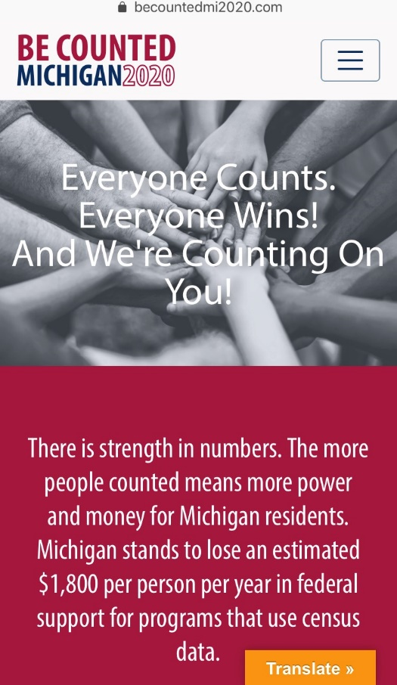
CAMPAIGN OVERVIEW
OUR CAMPAIGN
In July, 2017 Michigan Nonprofit Association (MNA) was awarded a 3-yr. grant from the W.K. Kellogg Foundation to launch 2020 Michigan Nonprofit Counts Campaign. Since then more than 40 foundations and the State of Michigan have invested in the campaign.
Modeled on a similar campaign MNA did for Census 2010, the 2020 Michigan Nonprofits Count Campaign is a collaborative, coordinated, statewide effort to encourage participation in the census in communities that are at significant risk of being undercounted.

Slide 3
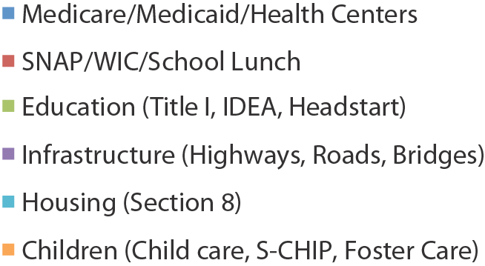
WHAT’S AT STAKE?
LARGEST FEDERAL SOURCES THAT USE
CENSUS DATA FOR DISTRIBUTION
Accurate census data are essential for the fair distribution of the country’s 435 congressional seats and for the fair allocation of government resources
Michigan is at risk of losing another seat this time
More than 15 billion federal and state program dollars were distributed to Michigan communities annually based on census data
This is particularly important for Michigan because about 42% of our state budget relies on federal funding

Slide 4
WHY NONPROFITS?
MICHIGAN NONPROFITS: UNIQUELY QUALIFIED TO MOBILIZE THE HARD-TO-COUNT POPULATIONS FOR CENSUS 2020 Historically, the Census has missed disproportionate numbers of
racial minorities,
immigrants, young children and those living in poverty (“hard-to-count populations”) leading to
inequality in political power, government funding and private-sector investment for
these communities.
WHY NONPROFITS TO MOBILIZE THE
HARD-TO-COUNT POPULATIONS:
• Located in communities most at risk of being under counted – urban and rural.
• Maintain everyday contact and have trusting
relationships with the communities they serve.
• Manage cultural sensitivities and language needs
within their communities.
• Nonprofits driven by social missions strive to ensure their communities have access to the funds, services,
representations, and physical and social infrastructure
affected by the Census count.
• Nonprofits are keenly aware of the negative impact
an undercount will have on their communities, and
that they will need to find ways to make up for
the shortfalls.

Slide 5
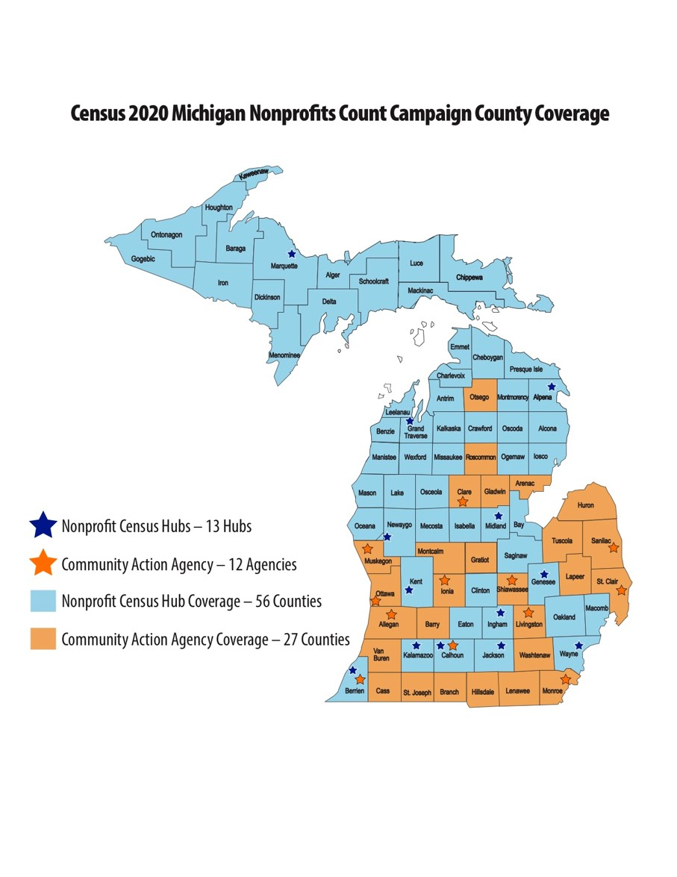
CAMPAIGN COVERAGE

Slide 6
CENSUS OPERATIONS 101

Slide 7
WHO IS COUNTED?
TIMELINE FOR RESPONDING
Invitations to fill out the census will go out in waves, starting in
March 2020.
Households will have until
July 2020 to fill out the census.
HOW TO FILL OUT THE CENSUS
Every household will have the option to self-respond one of three ways:
Internet (on-line)
Telephone
Paper questionnaire
All persons living in the United States on April 1, 2020 are counted in the census at the place of residence where they live/sleep most of the year.
Every household will receive an invitation to fill out the 2020 census.
One person from the house will fill out the census and include everyone living at that address – relatives/non-relatives, legally/ illegally.

Slide 8
CENSUS ASSISTANCE
Online census will be available in English and 12 non-English languages:
Spanish, Chinese (simplified), Vietnamese, Korean, Russian, Arabic, Tagalog, Polish, French, Haitian Creole, Portuguese, & Japanese.
Phone assistance for the census will be available in English and 13 non-English languages:
Spanish, Chinese Mandarin, Chinese Cantonese, Vietnamese, Korean, Russian, Arabic, Tagalog, Polish, French, Haitian Creole, Portuguese, & Japanese.
Paper questionnaire and mailing materials will be available in English and Bilingual English/Spanish.
ADDITIONAL LANGUAGE GUIDES + RESOURCES
Video + Print language guides will be available in 59 non-English languages.
Language guides will include versions in American Sign Language, braille, and large print.

Slide 9
SPECIAL CIRCUMSTANCES
Places where people stay in a group living arrangement that are owned/managed by an entity providing housing and/or services for the residents are counted at that facility. THINK: college dorms, military installations, nursing homes, prisons, hospitals, shelters, etc.
The Residence Criteria used to determine where people are counted during the 2020 Census say:
Count people at their usual residence, where they live/sleep most of the time.
People in certain types of group quarters are counted at the group facility.
People who do not have a usual residence or cannot determine a usual residence, are counted where they are on April 1, 2020.
GROUP QUARTERS
Places without reliable mail service, with high seasonal turnover, or recovering from natural disasters, and American Indian reservations. Census workers will go door-to-door to “update” address list and hand-deliver (“leave”) materials.
UPDATE/
LEAVE
In person counts conducted by Census Bureau officials is the primary mode for data collection for this population. Includes people living in RV parks, campgrounds, racetracks, circuses, carnivals, marinas, hotels, and motels.
TRANSITORY

Slide 10
NON-RESPONSE FOLLOW-UP
Every household that doesn’t respond to the initial invitation to fill out the census will be sent reminders in the mail (including eventually, a paper questionnaire) before someone follows up in person.
This non-response follow-up will begin in April 2020 with college housing and continue from May through July 2020.
Call centers will not be used for non-response follow-up.
What happens if you don’t respond to the census?
Timeframe | March 12 – 20 | March 16 – 24 | March 26 – April 3 | April 8 – 16 | April 20 - 27
What’s sent | Initial invitation | Reminder letter | Reminder postcard | Reminder letter + paper questionnaire | Final reminder postcard

Slide 11
WHAT DOES THE CENSUS ASK?

Slide 12
CENSUS QUESTIONS
How many people are
living or staying at your home on April 1, 2020.
Whether the home is owned or rented.
About the sex of each person in your home.
About the age of each person in your home.
About the race of each person in your home.
About whether a person in your home is of Hispanic, Latino, or Spanish origin.
About the relationship of each person in your home.

Slide 13
EFFECTIVE NONPROFIT ENGAGEMENT STRATEGIES

Slide 14
OUTREACH PHASES
RAISE AWARENESS
Share the importance of the census with your nonprofit and those you serve. Some sample talking points you can consider adopting:
Our communities may be under-counted and we need to work together to address concerns
This is a very different census
Census engagement can be integrated into your nonprofit’s work
Now – Dec 2019
Now – Dec 2019
BUILD ORGANIZATIONAL CAPACITY
Educate yourself and your organization on Census 2020. How will the census affect your organization and the community you serve?
Jan – May 2020
MOTIVATE TO RESPOND / PARTICIPATE
Ask staff and constituents to get their friends and neighbors to complete the census online, by phone, or by paper. Make the Census a top community activity for April 2020.

Slide 15
SUGGESTED ACTIVITIES
SEPTEMBER – DECEMBER 2019
RAISE AWARENESS
Develop messages to connect the census to your work
Promote the census in your e-communications and social media platforms
Include at a conference or other convening
BUILD RELATIONSHIPS
Contact your local or regional census office about partnering
Advertise U.S. Census Bureau job opportunities
Contact your city and/or county about local complete count committees
Train community members to spread the word

Slide 16
SUGGESTED ACTIVITIES
JANUARY – MAY 2020
MOTIVATE / ENCOURAGE PARTICIPATION IN CENSUS
COMMUNITY PRESENTATIONS / OUTREACH
Hold educational or community forums
Present at meetings or conferences
Provide information at community events
Serve on local complete count committee
Phone banking / door-to-door educational canvassing
SHARE RESOURCES
Place posters / collateral in common areas
Give out informational postcards
Share sample census forms
Make computers/phones available to community
PROMOTE PARTICIPATION
Newsletter articles
Share on social media

Slide 17
THINGS TO CONSIDER
THIS IS AN EVOLVING PROCESS
A lot of things are still being determined by the Bureau, which means messaging and plans could be subject to change
COMMUNITIES’ CAPACITY
We need to meet communities where they’re at – how they are affected by what’s happening in the environment they’re in and how we enter these spaces
ORGANIZATIONAL CAPACITY
Understand the available bandwidth of your organization
RESOURCES + STAFF
Take the time to educate your staff and volunteers on the census, and make sure the resources you have available suit your needs

Slide 18
RESOURCES
BeCountedMI2020.com/Resources
Toolkits, downloadable posters and FAQ cards, information on the census
MIVoiceCounts.org
Videos on why the census is important to Michigan
Preview of census questions
2020census.gov
Census Bureau website with information the census
Censuscounts.org
National resources

Slide 19
Thank you!
www.MIVoiceCounts.org
www.becountedmi2020.com
THANK YOU!

